Slide 1
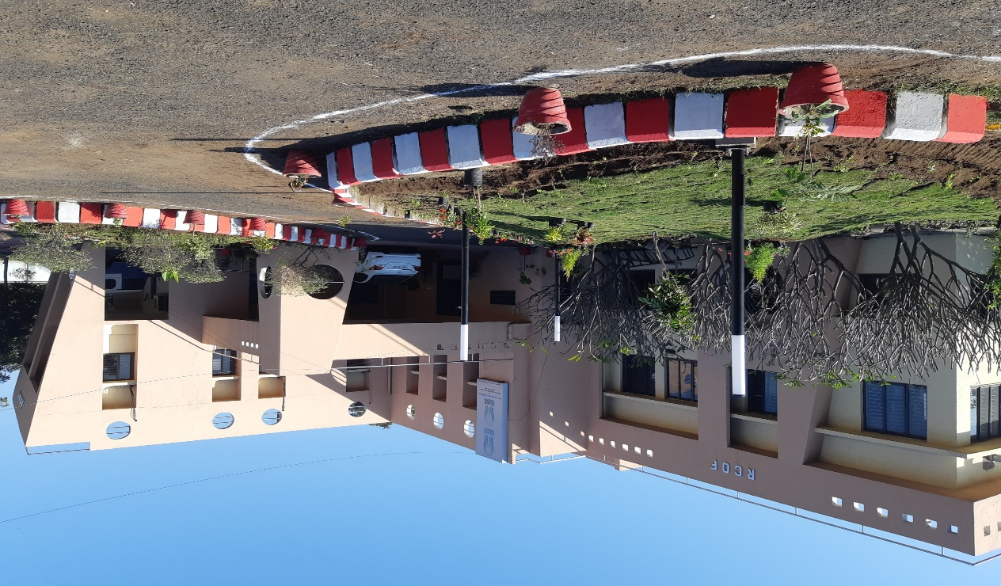
Government of India Initiatives & Interventions for
Promotion of Organic & Natural Farming
Dr.A.S. Rajput
Regional Director
Regional Centre of Organic and Natural Farming, Jabalpur & Nagpur
Ministry of Agriculture and Farmers Welfare, Govt. of India

Slide 2
National Centre for Organic and Natural Farming
Department of Agriculture & Farmers Welfare (Integrated Nutrient Management) Ministry of Agriculture & Farmers Welfare vide its letter no. F.No.6-6/2022-INM(107114) w.e.f 4th March, 2022 renamed
National Centre for Organic Farming (NCOF) as
National Centre for Organic and Natural Farming (NCONF).

Slide 3
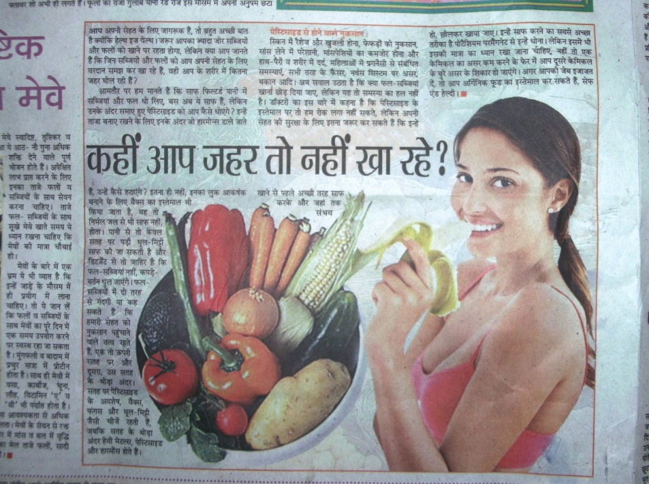
Issues in COVID-19 Era
SUCCESS IS NOT NEEDED WITH HIGHYIELDS,SUSTAINABLLE SOIL/HUMAN HEALTH IS PRIME CONCERNED

Slide 4
Mandate of NCONF/RCONF
i. Administration and monitoring of Office for National and Regional Centres of
NCONF.
ii. Promotion of chemical free agricultural systems like organic, natural, regenerative etc, farming in the country through capacity building of stakeholders.
iii. To function as National knowledge Repository for various organic and bio-fertilizer and assess market demand, supply and production capacities of production units in the country for such organic and biological inputs.
iv. To function as National knowledge repository for natural, organic and other chemical free sustainable farming systems, package of practices, best practices and success stories on natural and organic farming.
v. To serve as Nodal Quality Control laboratory for analysis of bio-fertilizers and organic fertilizers as per the requirement of Fertilizer Control Order, 1985 (FCO).

Slide 5
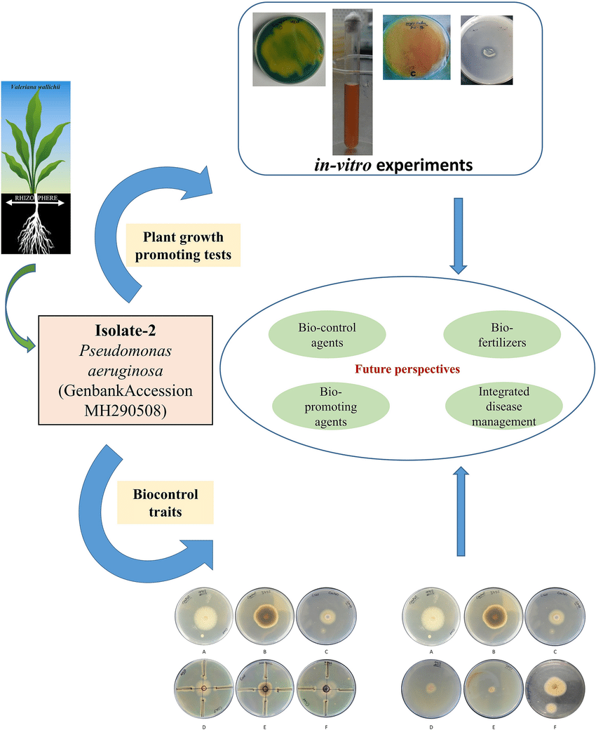
vi. To develop standards and testing protocols for various organic agricultural inputs.
vii. To develop facilities for testing, training, screening, monitoring and quality assessment of organic and natural farming products including facilities for agro chemical residue testing
viii. To develop, manage and keep on updating national database of organic and natural farming farmers, organic product producers, processors and input manufacturing facilities
ix. To serve as Secretariat for Organic, Natural farming and other chemical free sustainable Certification System and will also work for developing standards and compliance assessment protocol for other worldwide accepted product and process certification systems for chemical-free agricultural systems including agro-chemical residue free certification.

Slide 6
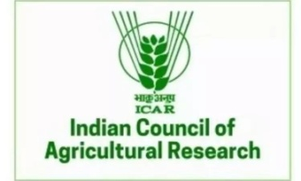
x. To co-ordinate and liaise with all scientific Institutes like MANAGE, SAMETI, ICAR, SAU etc and regulatory Institutes (FSSAI, APEDA, BIS, QCI, NABL and other Centre and State agencies) for ensuring quality at all levels for organic products and processes.
xi. To carryout IEC activities related to organic and natural farming system by organizing/participating in National I International Exhibitions/ Trade Fairs, Seminars and events.
xii. To create awareness and publicity by print and electronic media and publication of training literature, quarterly organic farming newsletter, half-yearly biofertiliser newsletter and validated and documented indigenous practices
xiii. To support Central and State Governments in policy formulation, monitoring, evaluation and introduction of new schemes, activities, programmes related to organic, natural and other forms of non-chemical farming systems.

Slide 7
Participatory Guarantee System –India
"Participatory Guarantee Systems are locally focused quality assurance systems. They certify producers based on active participation of stakeholders and are built on a foundation of trust, social networks and knowledge exchange”. In the case of organic agriculture, PGS is a process in which people in similar situations (in this case producers) assess, inspect and verify the production practices of each other and collectively declare the entire holding of the group as organic.
Guiding principles
Participation
Shared Vision
Transparency
Trust
Horizontality : Non-hierarchical at group level(all equal)collective responsibility
National networking

Slide 8
in 2015
PGS-India web-portal launched
Low cost decentralized certification system
Farmer- friendly and hassle-free.
Certified by farmers’ groups

Slide 9
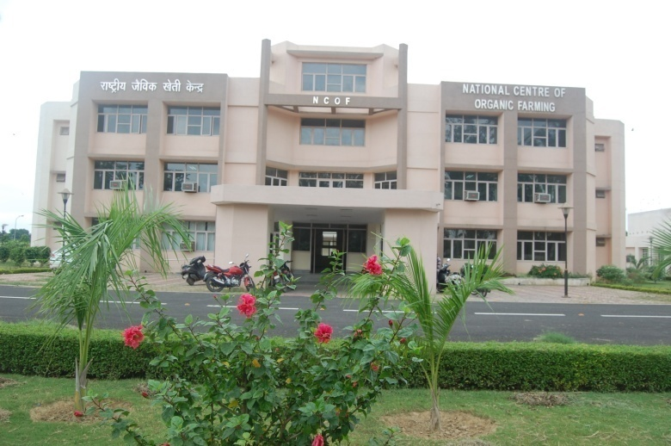
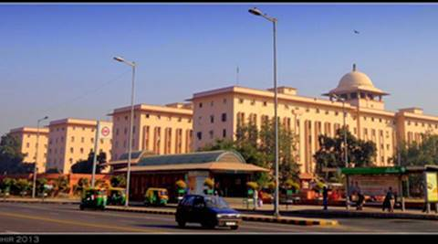
PGS- India : Organization structure
Existing NGOs
Organic Certification service providers of Central and State Governments
Any agency having expertise in organic certification
LG with 5 years experience
Group Leader
Farmer1
Farmer2
Farmer3
Farmer 4
Farmer/Farm family
Local Groups
Regional Councils
PGS-India Secretariat (NCOF)
PGS-India NEC/NAC

Slide 10
Local Group
Doc’s Incharge
PR & RC coordinator
Trg & Meet’g Coordinator
Group Leader
Peer review facilitator
Organic Farming/Produce
PGS-India standards

Slide 11
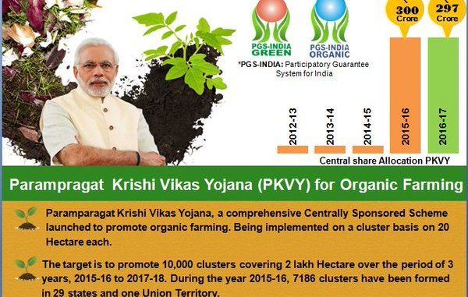
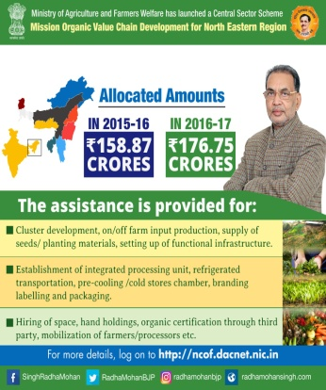
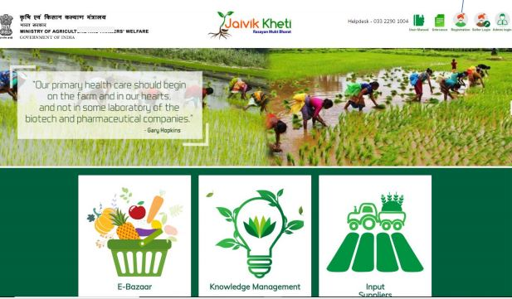
Govt. of India has launched
National Project on Organic Farming (NPOF) in year 2004 which is being implemented by National Centre of Organic Farming at Ghaziabad and its nine Regional Centres at Bangalore, Bhubaneshwar, Panchkula, Ghaziabad, Imphal, Jabalpur, Nagpur Patna and Gandhinagar.
two dedicated schemes namely Mission Organic Value Chain Development North Eastern Region (MOVCDNER) and Parampragat Krishi Vikas Yojana (PKVY) since 2015 through State Governments.
Participatory Guarantee System for India (PGS-India) facilitated by Ministry of Agriculture and Farmers Welfare, Govt. of India, cater the domestic organic market.
e-commerce platform-Jaivik Kheti portal (https://www.jaivikkheti.in/) to facilitate marketing of organic produce and easy access of the same for the consumers entailing low transaction cost.
Export of third party certified organic products is facilitated by Agriculture Processed Food and Export Development Authority (APEDA), Ministry of Commerce and Industries, Govt. of India
As per Agri Export Policy -2017 all kinds of organic products will not be brought under the ambit of any kind of export restriction (viz. Minimum Export Price, Export duty, Export bans, Export quota, Export capping, Export permit etc.)
PM appeal to Reduce the use of Chemical inputs by 30%
NPOF PKVY & PGS-India Jaivik kheti NPOP AEP-2017
MOVCDNER portal

Slide 12
Recent Approaches..….
Honorable PM exhorted the farmers on 74th Independence day, to reduce the use of chemical fertilizers by 10 to 25 %.
‘Aatma Nirbhar Bharat’ : next 5 year policy is to bring 14 million hectare land (i.e. approx 10% of total arable land) upto year 2025.
*The current organic farming coverage of 28 lakh hectares is a measly 2% of the total farm land.
Therefore, MoA&FW has set the target to bring additional 25 lakh hectares area under organic farming in next 2 years.
Pesticides Management Bill, 2020 has been introduced in Parliament in March 2020.

Slide 13
Some other Initiatives taken by MoA&FW
Promoted Organic Farming under Saansad Adarsh Gram Yojana in the selected villages adopted by the Hon’ble MPs in their respective constituencies
Namami Gange 2016: MoU with Union Water Resources Ministry to promote organic farming on the banks of the river Ganga in 1657 villages also under PKVY.
Continuously Taking PGS-India (low cost Organic certification system) upto another level to improve certification process.
In India, Natural farming is promoted as Bharatiya Prakritik Krishi Paddhati Programme (BPKP) under centrally sponsored scheme- Paramparagat Krishi Vikas Yojana (PKVY). BPKP is aimed at promoting traditional indigenous practices which reduces externally purchased inputs. It is largely based on on-farm biomass recycling with major stress on biomass mulching, use of on-farm cow dung-urine formulations; periodic soil aeration and exclusion of all synthetic chemical inputs.

Slide 14
Paramparagat Krishi Vikas Yojana (PKVY)

Slide 15
Mission Organic Value Chain Development for North Eastern Region (MOVCDNER)

Slide 16
Bhartiya Prakritik Krishi Padhati (BPKP)
Government is implementing Bhartiya Prakritik Krishi Padhati (BPKP) as a sub scheme of Paramparagat Krishi Vikas Yojana (PKVY) since 2020-21 for the promotion of traditional indigenous practices.
The scheme mainly emphasizes on exclusion of all synthetic chemical inputs and promotes on-farm biomass recycling with major stress on biomass mulching; use of cow dung-urine formulations; plant-based preparations and time to time working of soil for aeration.
Under BPKP, financial assistance of Rs 12200/ha for 3 years is provided for cluster formation, capacity building and continuous handholding by trained personnel, certification and residue analysis.

Slide 17
Bhartiya Prakritik Krishi Padhati (BPKP)
As of now, an area of 4.9 lakh ha is covered in 8 states and Rs. 4980.99 lakh has been released. Telangana has not taken up natural farming so far under BPKP programme.
The State –wise details of funds released under BPKP
Sl. No. | States | Area in Ha | Amount released (Rs in lakh)
1. | Andhra Pradesh | 100000 | 750.00
2. | Chhattisgarh | 85000 | 1352.52
3. | Kerala | 84000 | 1336.60
4. | Himachal Pradesh | 12000 | 286.42
5 | Jharkhand | 3400 | 54.10
6. | Odisha | 24000 | 381.89
7. | Madhya Pradesh | 99000 | 787.64
8. | Tamil Nadu | 2000 | 31.82
Total |  | 409400 | 4980.99

Slide 18
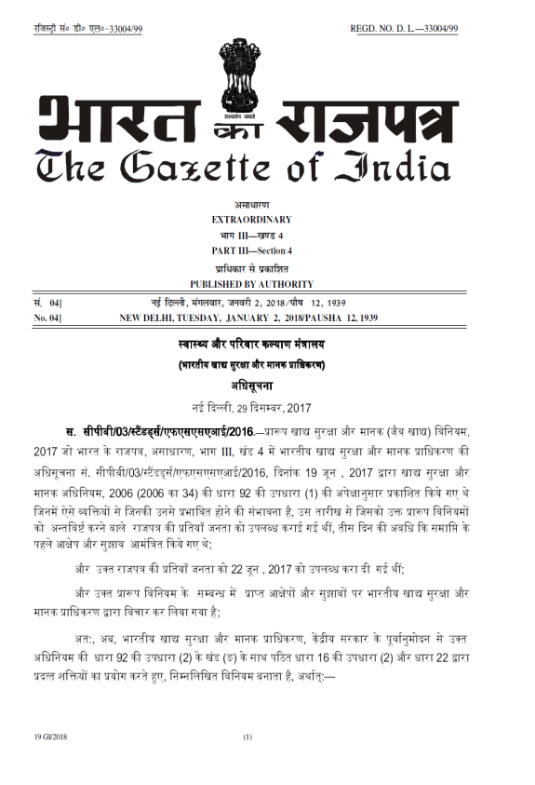
Regulation of Domestic Organic Market
PGS-India
FSSAI has brought regulation for organic foods in domestic market in India 2017 w.e.f 1st July,2018 under Food Safety and Regulation Act, 2006
The regulation clarifies that organic foods must be certified under NPOP or PGS-India for being sold in the domestic market under the license/logo of FSSAI.
The farmers/operators are exempted for selling their organic produce directly to the end consumers
Food Safety and Standard (Organic Foods) regulations, 2017, Section 22,
Chapter II for (Organic Food Levelling and Certification)
Chapter III for Import and Reciprocity-(Import of Organic Food)

Slide 19
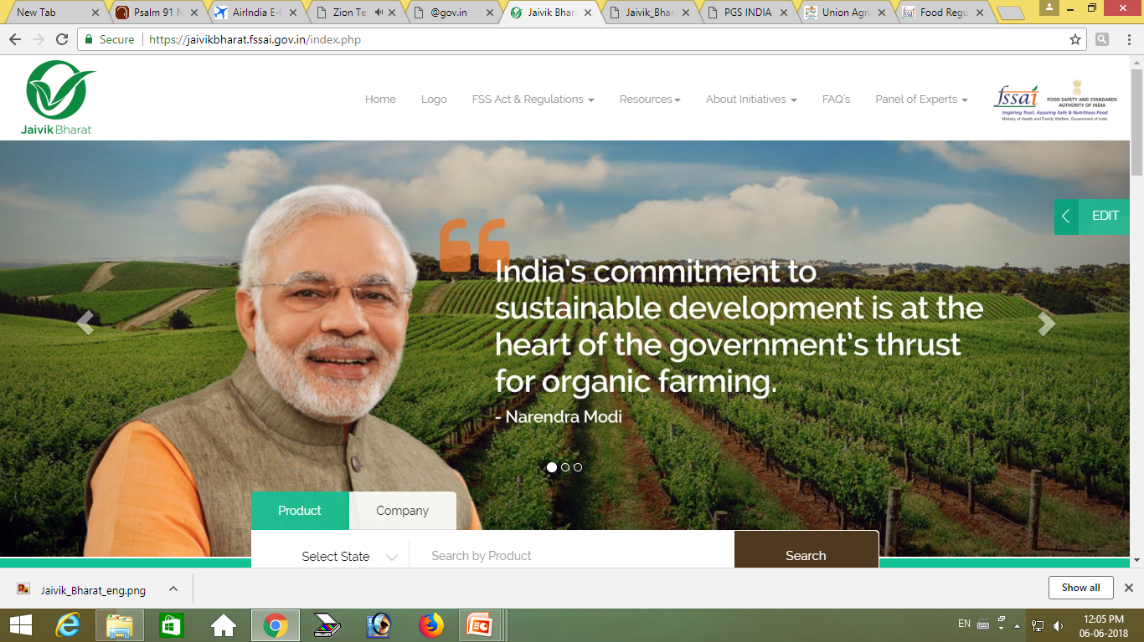
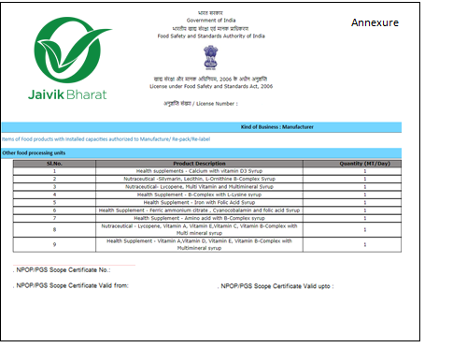
Steps for Obtaining Jaivik Bharat Logo
Obtain FSSAI licence
Endorse organic products
Enter NPOP or PGS number
Fetch all the details of product from APEDA based on the NPOP/PGS number
Follow the same flow as completion of FSSAI number
Submit the details
https://jaivikbharat.fssai.gov.in/

Slide 20
Jaivik Kheti Portal

Slide 21
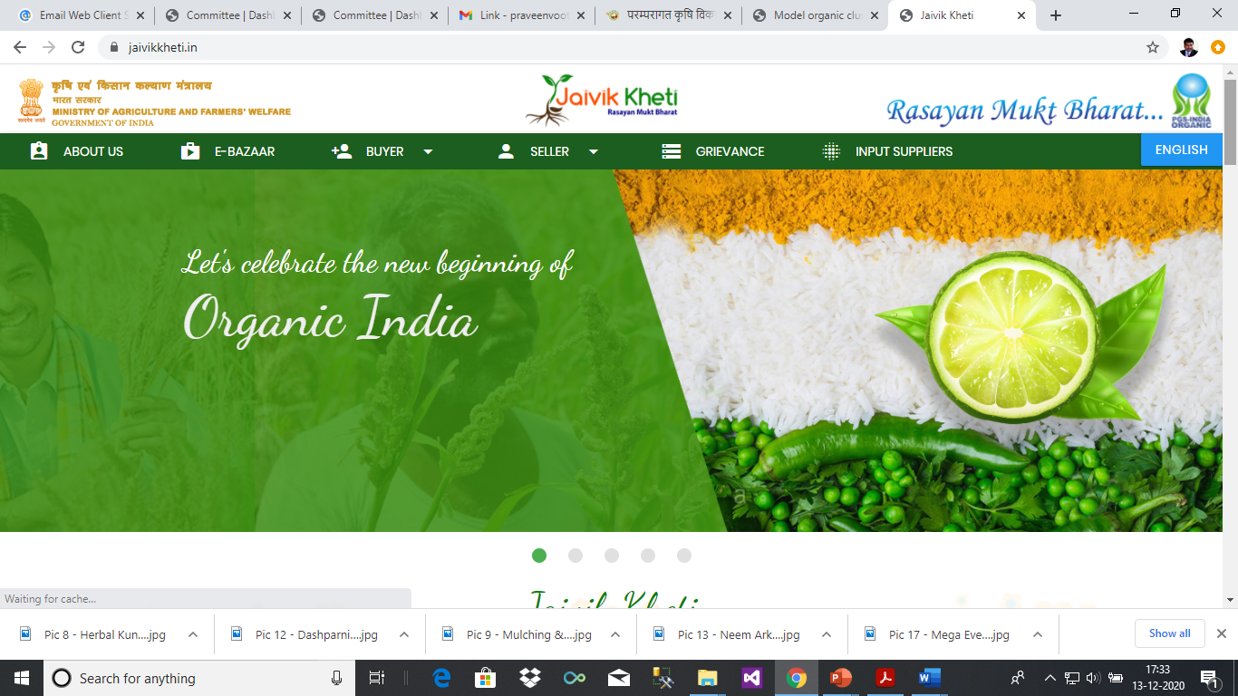
https://www.jaivikkheti.in/

Slide 22
MARKETING OF ORGANIC AGRI PRODUSES THROUGH YOUR MOBILE
MY MOBILE MY MARKET

Slide 23
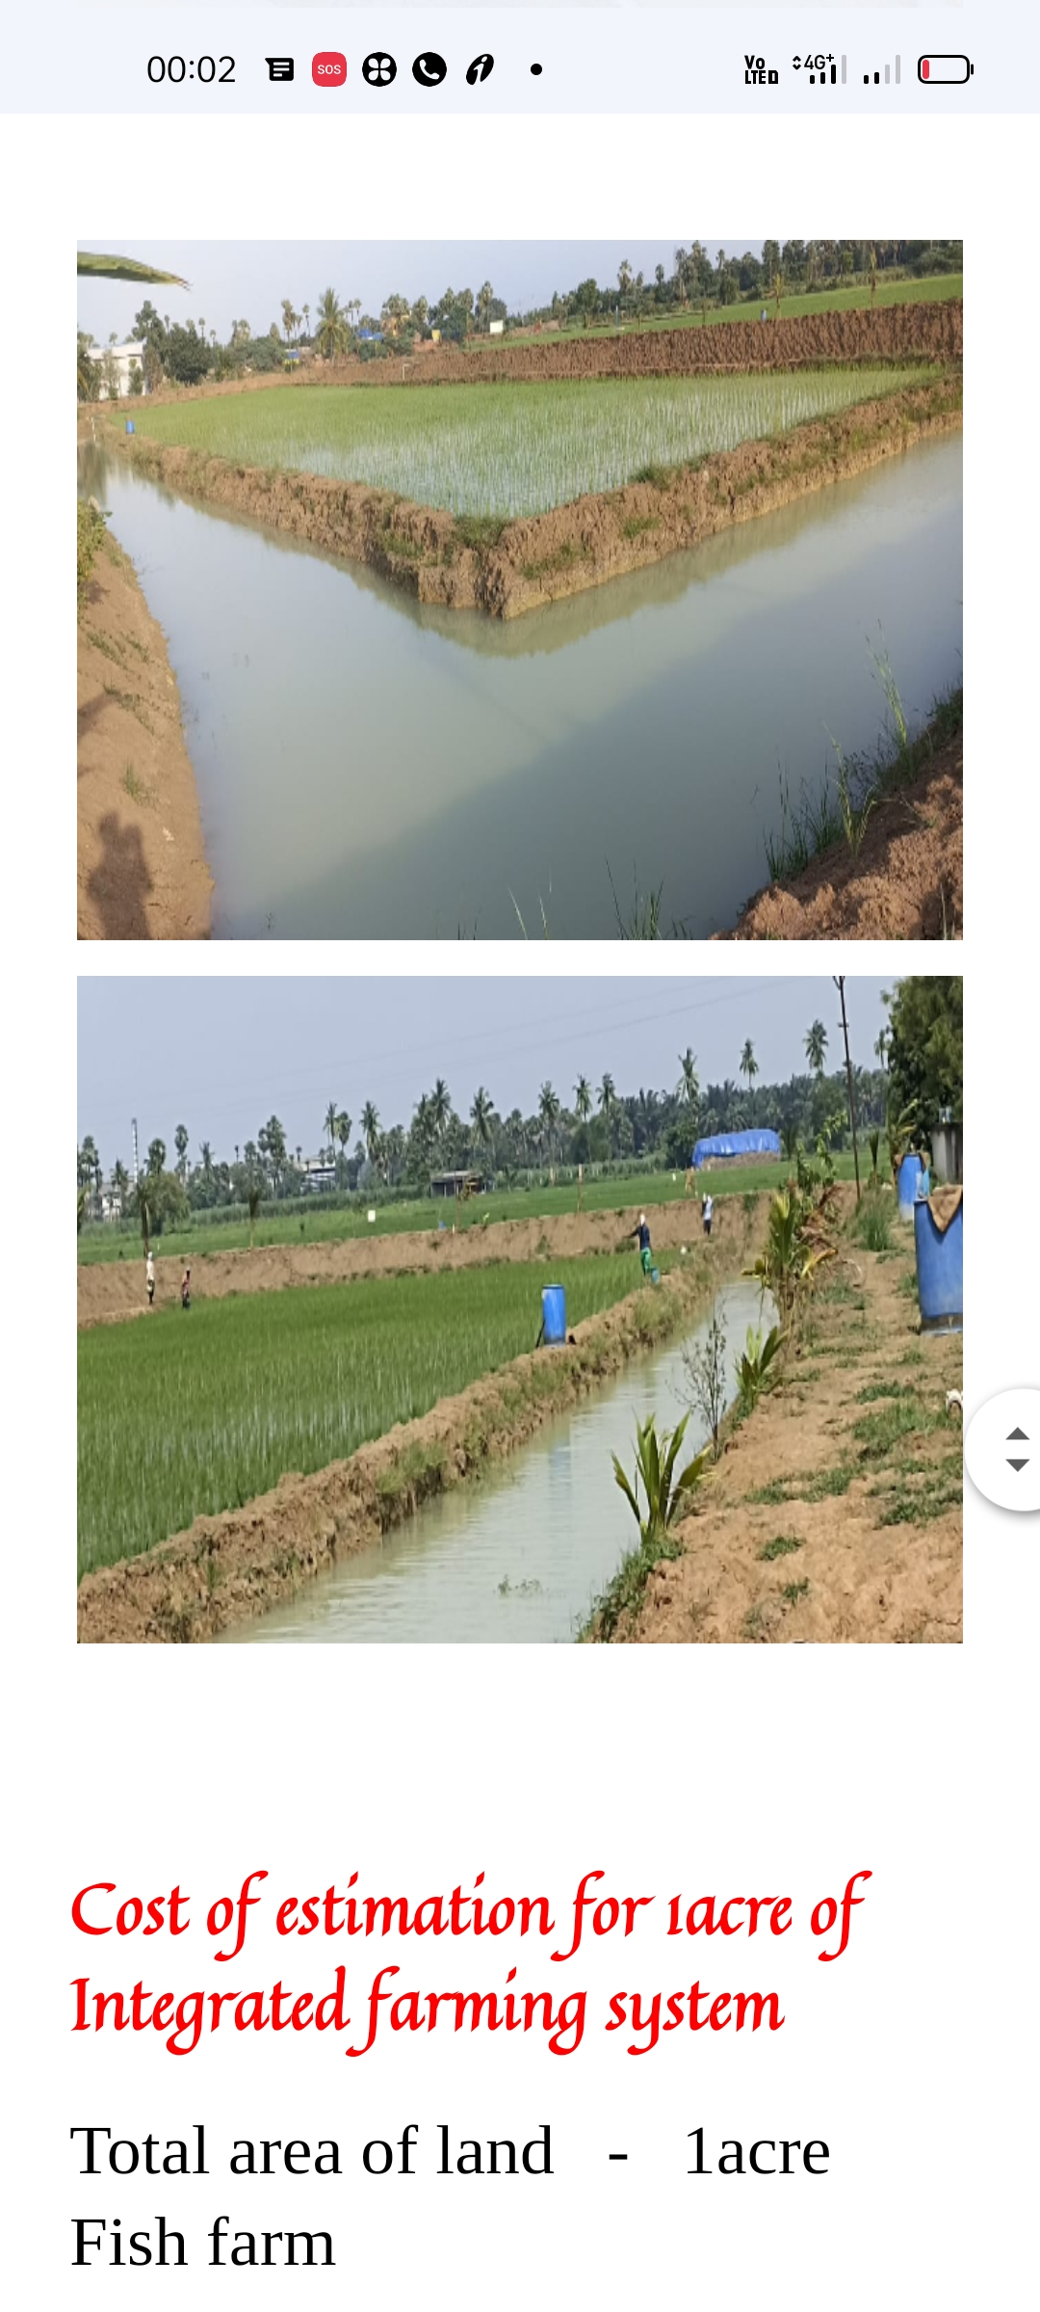
Ratana ji IFS Fish-Paddy system at AP

Slide 24
………THANK YOU

